Slide 1
Programming Intelligence Pt.1
Weekly Event

Slide 2


Slide 3
Learning Objectives
ABC of Machine Learning & its use-cases
Types of Machine Learning
ML Keywords
Problem Solving

Slide 4
What is Machine Learning
Machine learning is the study of computer algorithms that improve automatically through experience.
It allow computers to discover hidden and useful insights
In nutshell, Machine Learning is a new way of communicating your wishes to a computer.

Slide 5
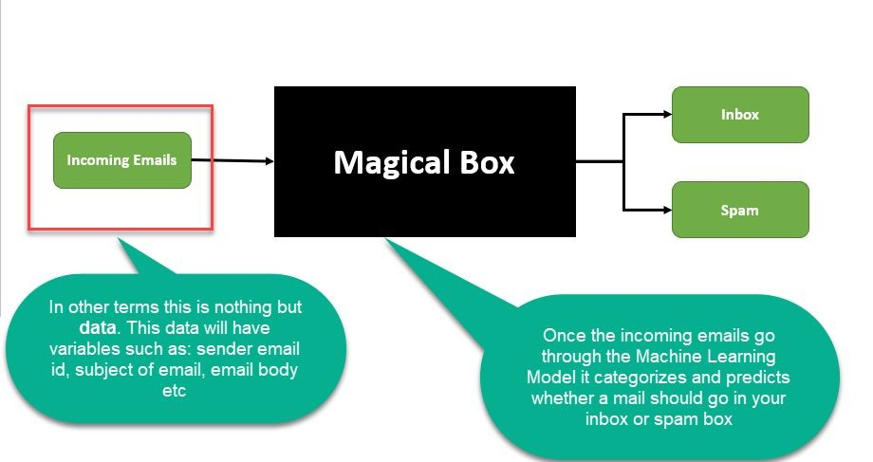
Where is it used?

Slide 6
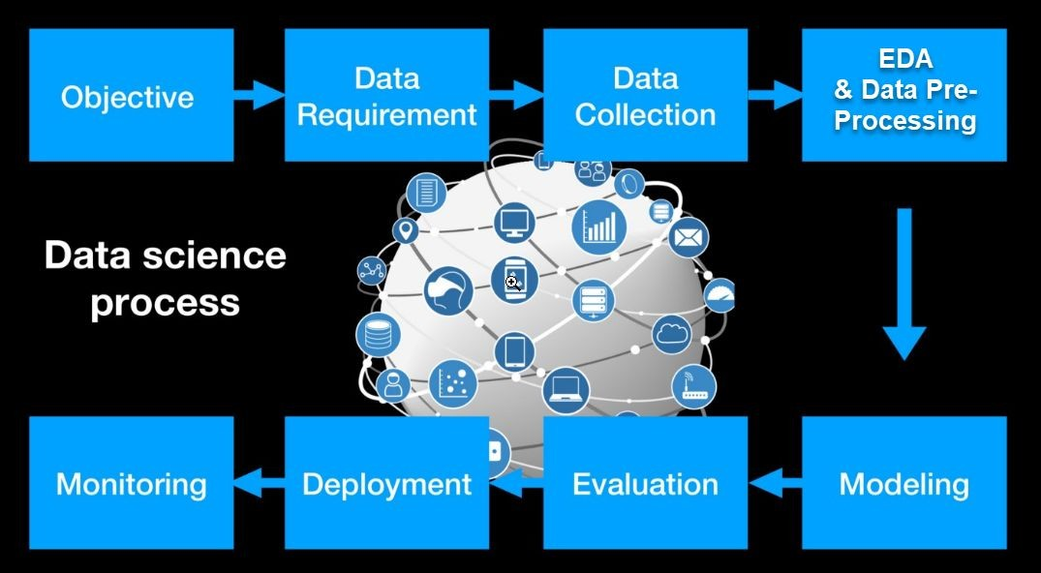

Slide 7
Fraud detection - Eg: Credit card fraud detection. It will help us to detect whether a transaction is fraud or not.
Email spam ﬁltering - Eg: Helps in categorising whether a particular email should go in inbox or spam box.
Recommendation engines - Eg: E-commerce platforms like Amazon can recommend you a similar product based on your previously browsed list of products
and many more!!!

Slide 8

Let’s understand some keywords in ML!
10

Slide 9
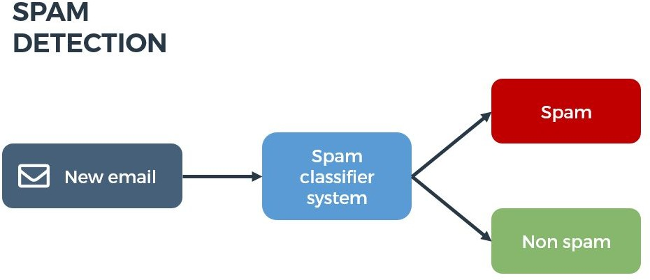
The target variable or label of a dataset is the variable of a dataset about which you want to gain a deeper understanding.
It is the variable that is, or should be the output.
In the example of detecting spam emails, the label will be the category the email belongs to, i.e it will be either ‘spam’ or ‘not spam’.

Slide 10

One or more variables that are used to determine (or predict) the 'Target Variable' are known as Input Variables. They are sometimes called Predictor Variable as well.
In the spam detector example, the features could include the following:
words in the email text
sender's address
time of day the email was sent
email contains the phrase "congrats you won $1 billion - share your bank details."

Slide 11
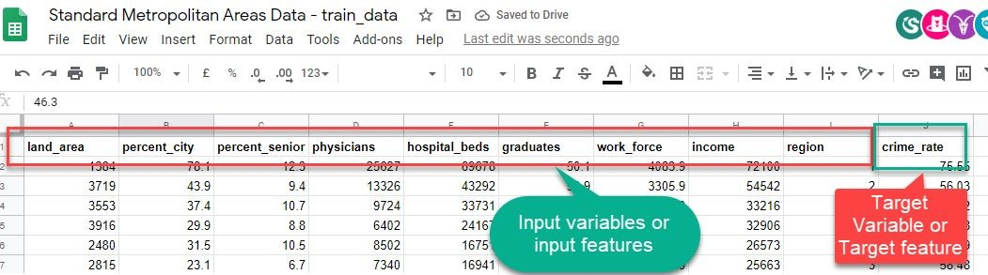
Standard Metropolitan Areas Data: In this dataset we might be curious to predict “crime_rate” in future, so that becomes our target and rest of the variables become input variables or features for building a machine learning model.

Slide 12
Types of Machine Learning
Supervised Learning
Classiﬁcation
Regression
Unsupervised Learning
Reinforcement Learning

Slide 13
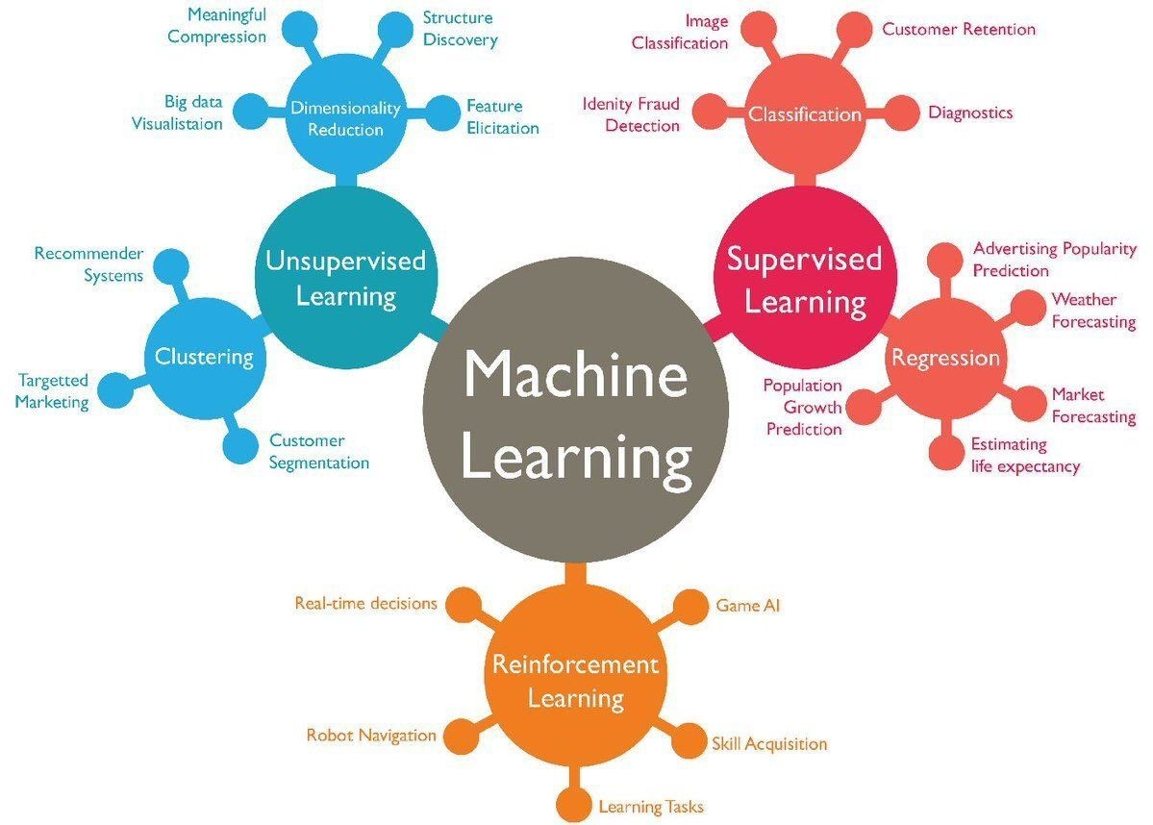

Slide 14
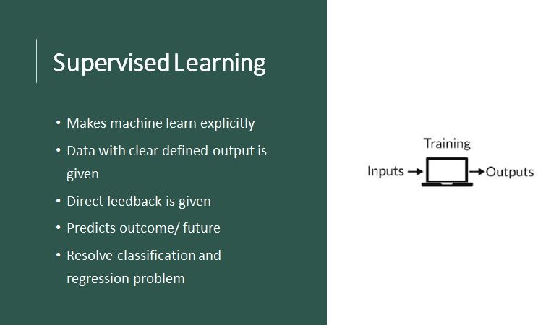

Slide 15
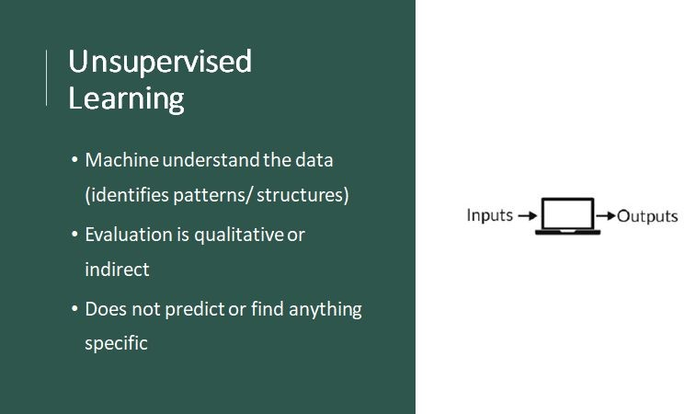

Slide 16
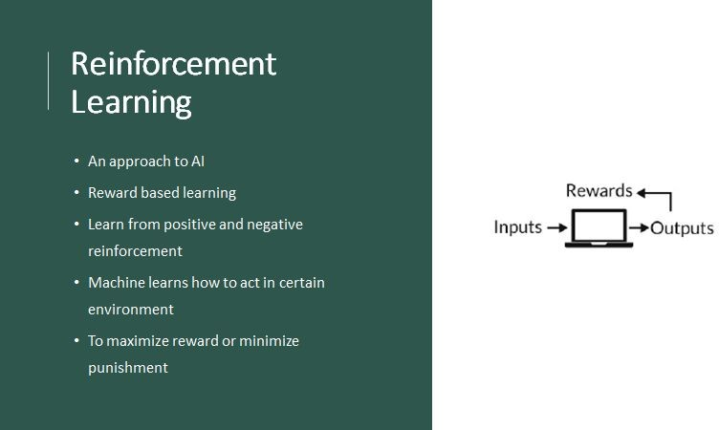

Slide 17
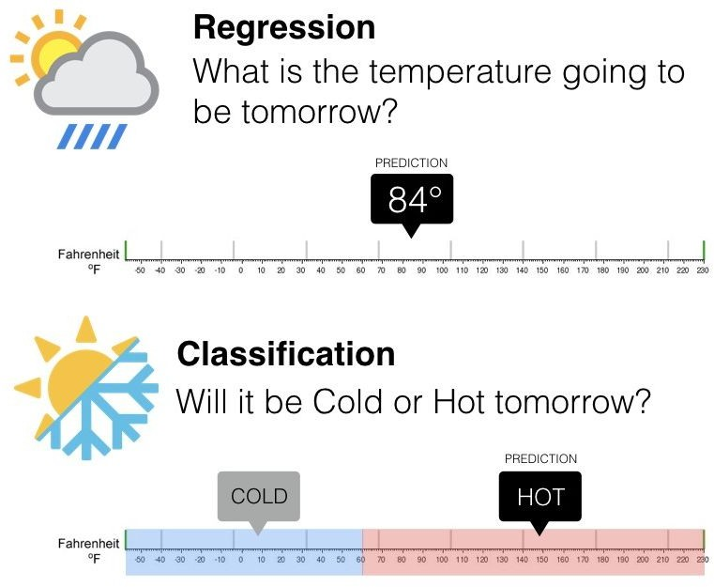
Supervised Learning

Slide 18
Classiﬁcation:
Classify the outcome
Examples:
Predict whether a transaction is fraud or not fraud
Predict whether to give loan or not
Predict whether to give college admission or not
Predict the grade (Grade A, B, C, D)
Note: Classiﬁcation can be more than two
Regression
Regression is the problem of predicting a continuous outcome (a numeric outcome)
Examples:
Predict house price
Predict crime rate

Slide 19
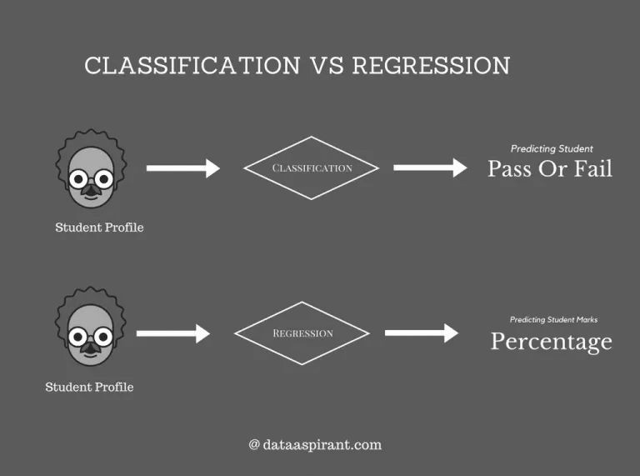

Slide 20
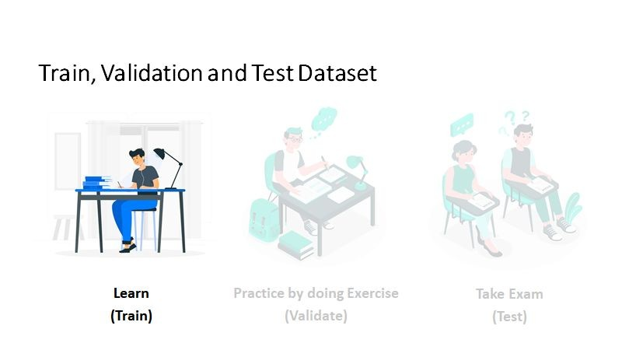

Slide 21
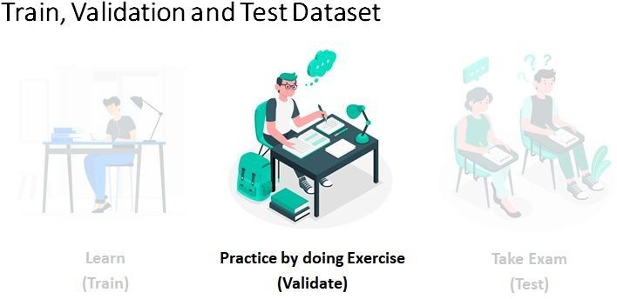

Slide 22
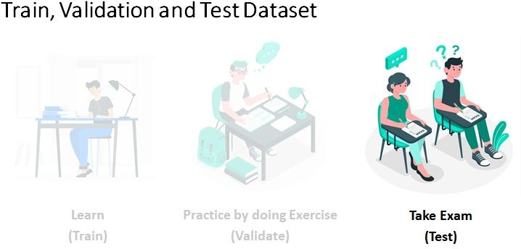

Slide 23
What if the paper gets leaked?
And, what if the university get to know that and the test paper changes in the last minute?
Crux of the story: We should never expose test data while training a model as it might lead to overﬁtting that might give you good results for that particular data but when exposed to new data we might get bad results.

Slide 24
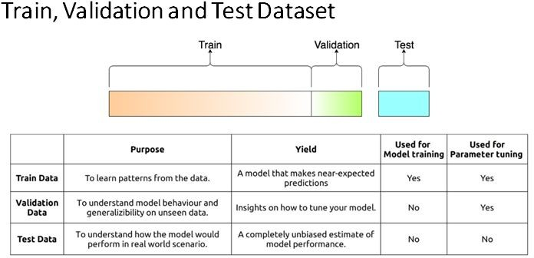

Slide 25
Its time to move on from theory

Slide 26
For further doubts and updates
Follow us on instagram : https://www.instagram.com/ieeessit/?r=nametag
https://github.com/ieeessitvit

